Slide 1
The Cabinet
The President’s Advisers and Administrations
We call them “Secretaries”

Slide 2
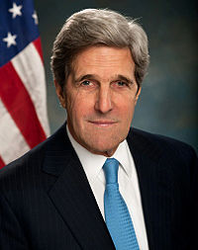
Secretary of State (1789)
Leader of the State Department
Represents the U.S. at the UN
Staffs U.S. Embassies abroad
Protects citizens traveling abroad
John Kerry

Slide 3
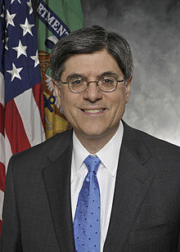
Secretary of the Treasury (1789)
Leader of the Treasury Department
Collects taxes
Manufactures coins and paper money
Includes the Secret Service
Responsible for borrowing money to operate the federal government
Jacob Lew

Slide 4
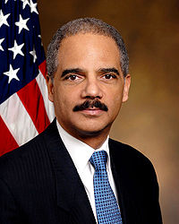
Attorney General (1789)
Leads the Department of Justice (which was established in 1870)
Includes the FBI, U.S. Marshals Service, and the Drug Enforcement Administration
Eric Holder

Slide 5
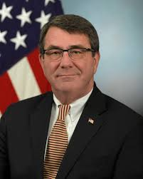
Secretary of Defense (1789/1949)
Originally the War Department—merged with Department of the Navy in 1949 now the Defense Department
Includes the Joint Chiefs of Staff (leaders of the military branches)
Is the largest department, with its headquarters in the Pentagon
Ashton Carter

Slide 6
Secretary of the Interior (1849)
Leader of the Interior Department
Manages the mining of natural resources
Protects national parks
Manages historic sites, national monuments
Sally Jewell

Slide 7
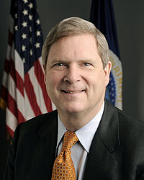
Secretary of Agriculture (1889)
Leads the Department of Agriculture
Safeguards the nation’s food supply
Extends financial credit to farmers
Tom Vilsack

Slide 8
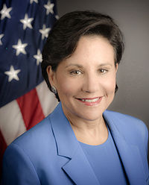
Secretary of Commerce (1913)
Leads the Commerce Department
Coordinates the Census
Promotes international trade
Issues patents and registers trademarks
Provides uniform standards for weights and measures
Penny Pritzker

Slide 9
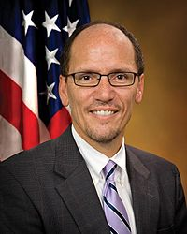
Secretary of Labor (1913)
Leads the Labor Department
Ensures safe working conditions
Protects the minimum wage
Analyzes data on employment, wages, and compensation
Thomas Perez

Slide 10
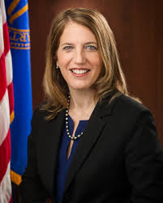
Secretary of Health and Human Services (1953)
Leads the Health and Human Services Department
Ensures the safety of food and drugs
Manages (Mismanages?) Medicare/Medicaid, and, now, the Affordable Care Act
Funds medical research
Sylvia Mathews Burwell

Slide 11
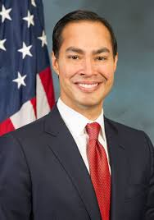
Secretary of Housing and Urban Development (1966)
Leads the Housing and Urban Development Department
Provides block grants to develop communities
Helps make mortgage money available for people to buy homes
Julian Castro

Slide 12
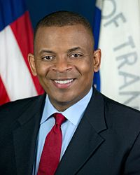
Secretary of Transportation (1966)
Leads the Transportation Department
Maintains and regulates national highways, air travel, railroads, and mass transit
Anthony Foxx

Slide 13
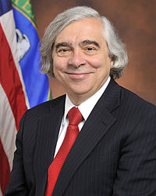
Secretary of Energy (1977)
Leads the Energy Department
Provides transmission of electricity and natural gas between states
Works to develop clean coal technology
Ernest Moniz

Slide 14
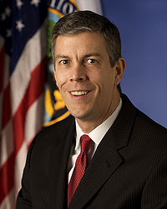
Secretary of Education (1980)
Leads the Education Department
Oversees programs to promote equal opportunities among students
Creates programs to promote literacy, science and math, and the involvement of girls in athletics
Arne Duncan

Slide 15
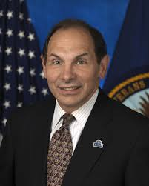
Secretary of Veterans Affairs (1988)
Leads the Department of Veterans Affaris
Provides educational programs to benefit former soldiers and their families
Administers national cemeteries and hospitals
Robert McDonald

Slide 16
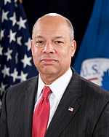
Secretary of Homeland Security (2003)
Leads the Homeland Security Department
Secures and manages U.S. borders
Secures cyberspace
Created in response to the 9/11 attacks
Controls the Coast Guard, Border Patrol, FEMA, and the Customs Service
Jeh Johnson

Slide 17
The Federal Bureaucracy
The Cabinet is just part of what has become the federal bureaucracy.
What is a bureaucracy?
Three features distinguish bureaucracies:
Hierarchical authority. Bureaucracies are based on a pyramid structure with a chain of command running from top to bottom.
Job specialization. Each bureaucrat, or person who works for the organization, has certain defined duties and responsibilities.
Formalized rules. The bureaucracy does its work according to a set of established regulations and procedures.

Slide 18
Major Elements of the Federal Bureacracy
The federal bureaucracy is all of the agencies, people, and procedures through which the Federal Government operates.
The President is the chief administrator of the Federal Government.
In order to enact and enforce policy, Congress and the President have created an administration—the government’s many administrators and agencies.
The chief organizational feature of the federal bureaucracy is its division into areas of specialization.

Slide 19
The Name Game
The name department is reserved for agencies of the Cabinet rank.
Outside of department, there is little standardization of names throughout the agencies.
Common titles include agency, administration, commission, corporation, and authority.

Slide 20
The Executive Departments
The executive departments, often called the Cabinet departments, are the traditional units of federal administration.
Each department is headed by a secretary, except for the Department of Justice, whose work is directed by the attorney general.
Each department is made up of a number of subunits (bureaus, agencies, commissions, etc.).
Today, the executive departments vary a great deal in terms of visibility, size, and importance.

Slide 21
Independent Agencies
The independent agencies are created by Congress and located outside the executive departments.
Independent agencies have been formed for numerous reasons, including:
being assigned a task or function that does not fit well within the existing departmental structure;
protecting the agency’s purposes from the influence of both partisan and pressure politics;
being created outside the departmental structure by accident.

Slide 22
Independent Executive Agencies
The independent executive agencies include most of the independent agencies.
The most important difference between the independent executive agencies and the 14 executive departments is that they simply do not have Cabinet status.
Examples of independent executive agencies include NASA, the General Services Administration, and the EPA.
Some independent executive agencies are far from well-known, such as the Citizens’ Stamp Advisory Committee.

Slide 23
Independent Regulatory Commissions
The independent regulatory commissions stand out among the independent agencies because they are largely beyond the reach of presidential direction and control.
Term length of members and staggering of member appointments keep these commissions from falling under control of one party.
The regulatory commissions are quasi-legislative and quasi-judicial, meaning that Congress has given them certain legislative-like and judicial-like powers.

Slide 24
Government Corporations
Government corporations are also within the executive branch and subject to the President’s direction and control.
Government corporations were established by Congress to carry out certain business-like activities.
There are now over 50 government corporations, including the U.S. Postal Service, Amtrak, and the Tennessee Valley Authority.

Slide 25
Development of the Civil Service
The civil service is that group of public employees who perform the administrative work of government, excluding the armed forces.
The use of patronage—the practice of giving government jobs to supporters and friends—was in use throughout most of the nineteenth century.
The Pendleton Act, also known as the Civil Service Act of 1883, laid the foundation of the present federal civil service system, and set merit as the basis for hiring in most civil service positions.

Slide 26
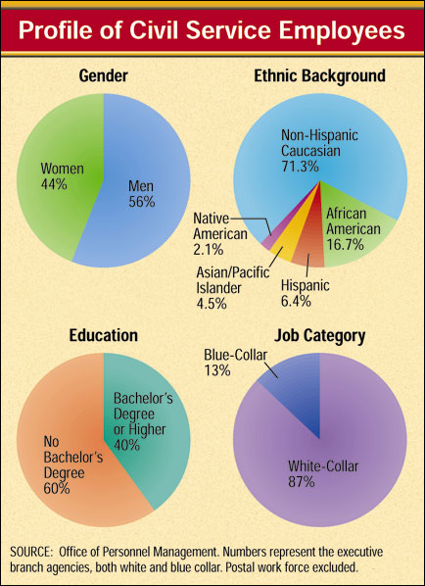
The Civil Service Today
The Office of Personnel Management is the central clearinghouse in the federal recruiting, examining, and hiring process.
The Merit Systems Protection Board enforces the merit principle in the federal bureaucracy.
Congress sets the pay and other job conditions for everyone who works for the Federal Government, except for postal employees.

Slide 27
Political Activities
Several laws and a number of OPM regulations place restrictions on the political activities of federal civil servants:
The Hatch Act of 1939 allows federal workers to vote in elections, but forbids them from taking part in partisan political activities.
The Federal Employees Political Activities Act of 1993 relaxes many of the restrictions of the Hatch Act. It still forbids federal workers from:
(1) running in partisan elections;
(2) engaging in party work on government property or while on the job;
(3) collecting political contributions from subordinates or the general public; or
(4) using a government position to influence an election.

